Slide 1
Clergy Work-Family Conflict, Psychological Distress, and Well-Being Martin Lee hsiuchilee@fuller.edu

Slide 2
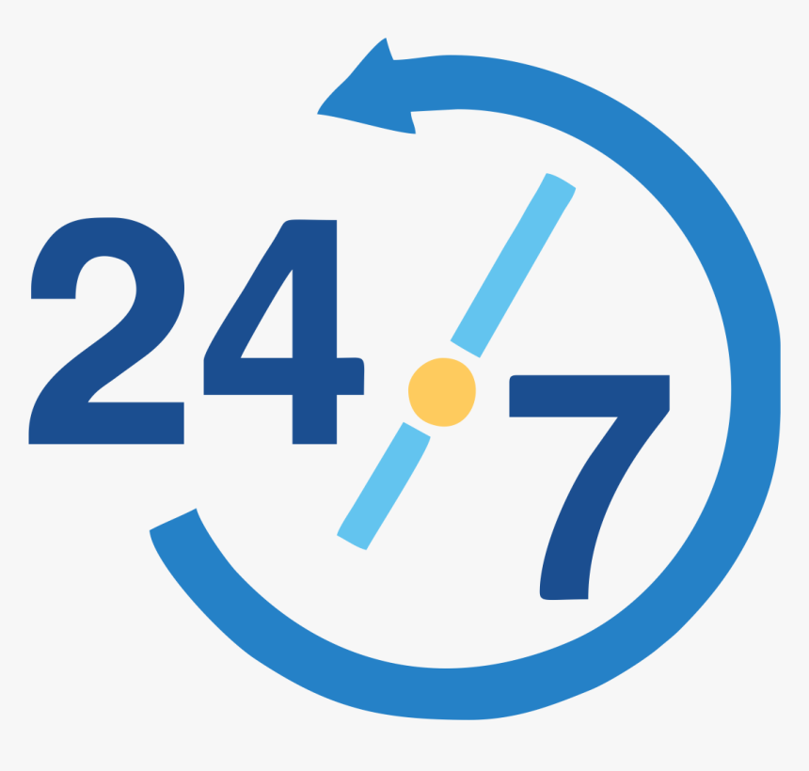
Clergy face various stressors
24/7 on call nature
Blurred line between work and family life
Fishbowl experience
Unrealistic expectation

Slide 3
Work-Family Conflict (WFC)
”A form of interrole conflict in which the role pressures from the work and family domains are mutually incompatible in some respect" (Greenhaus & Beutell, 1985).

Slide 4
Four types of WFC
 |  | Directionality
 |  | Work to Family | Family to Work
F o r m | Time | Time-Based Work to Family | Time-Based Family to work
 | Strain | Strain-Based Work to Family | Strain-Based Family to Work
Work
Family
Having to miss out a family dinner due to a hospital visit of a congregant
Having to miss a meeting or a training opportunity due to family responsibilities
Can’t do chores after an emotionally drained workday
Emotionally preoccupied at work due to family matters

Slide 5
Psychological Distress Indicators
Emotional Exhaustion
Burnout
(MBI; Maslach & Jackson, 1981)
Depersonalization
Low Personal Accomplishment
Anxiety
(BAI; Beck et al., 1988)
Depression
(CES-D; Cole et al., 2004)

Slide 6
Well-Being Indicators
Life Satisfaction
(Diener et al., 1985)
Spiritual Well-Being
(Proeschold-Bell et al., 2014)
Flourishing
(Diener et al., 2010)

Slide 7
Hypothesized Model

Slide 8
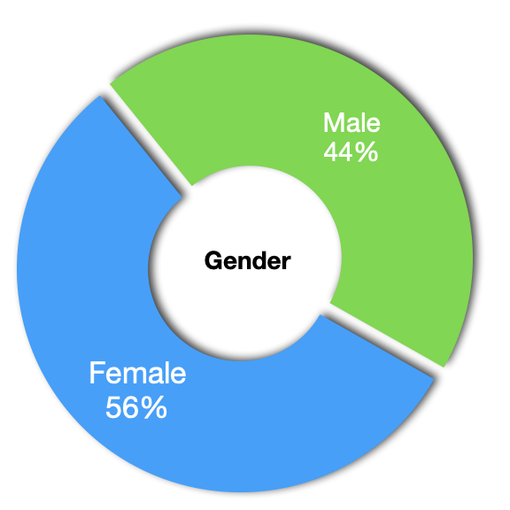
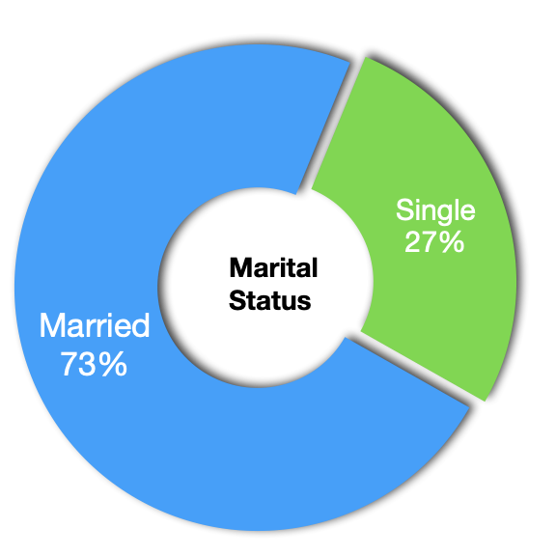
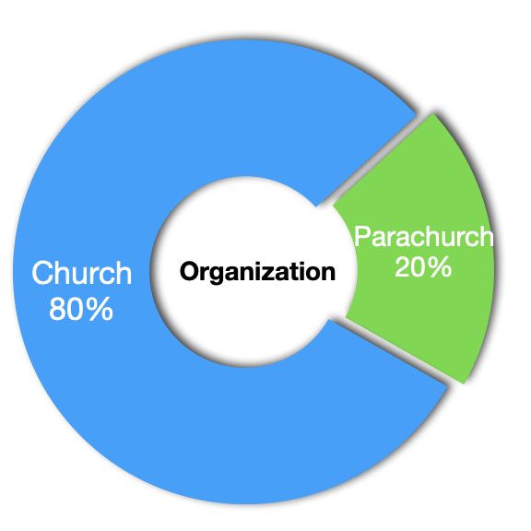
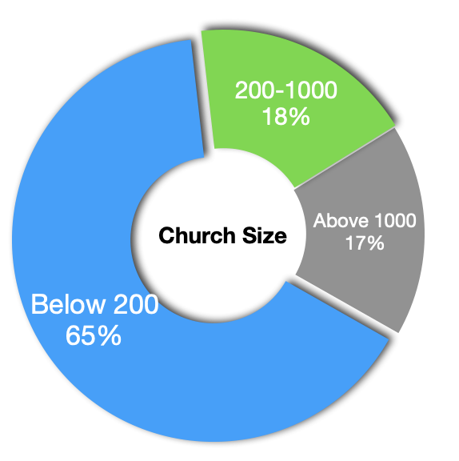
Clergy Sample from Taiwan, N = 336
Age: 24-75 (M = 46.3, SD = 11.5)
Years in ministry:1 to 40 years (M = 11.9, SD = 10.2)
Denominations: ↑21

Slide 9
What are the top three stressors you experienced as a clergy/therapist/researcher?
Of the following four types of work family conflict, which one do you relate the most? Why?
1. Time-based work to family
2. Time-based family to work
3. Strain-based work to family
4. Strain-based family to work

Slide 10
Psychological Distress Indicators
Moderate to Severe Depression: 15.5% (prevalence 8.9%)
Severe Anxiety: 9.5%
High Emotional Exhaustion: 22%
Low Personal Achievement: 23%
High Depersonalization: 8%

Slide 11
Well-Being Indicators
Satisfied with Current Life: 35%
Often Experience a sense of Flourishing: 43%
Often Experience God’s Presence and Power: 59%

Slide 12
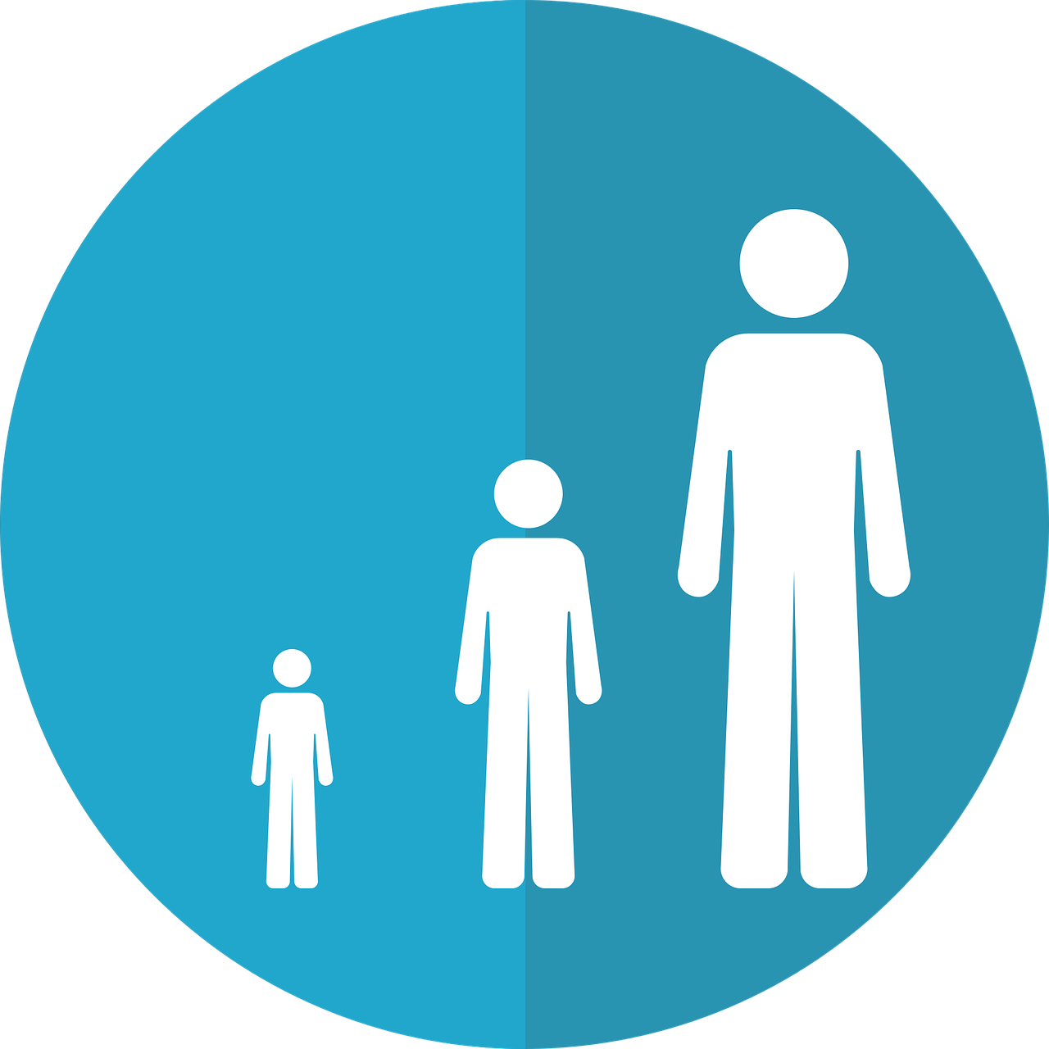
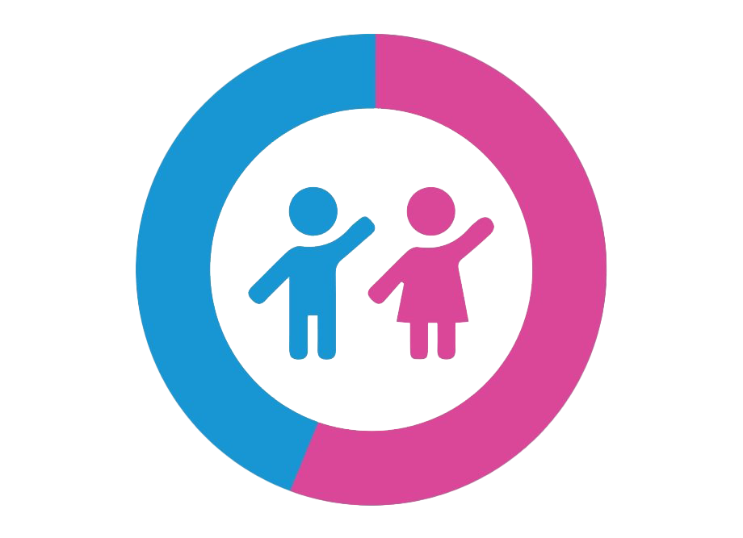
Demographics that Impacted Clergy’s Well-Being
Age
Gender
Marital Status
Income
Work Style

Slide 15
We found that only strain-based (not time-based) work family conflict were related to psychological distress and well-being. Were you surprised by this finding? Was it congruent with your experience?
What strategies have you found helpful in coping strain-based work family conflict?

Slide 16
Implications
Work-Family Conflict is a risk factor of psychological distress and well-being
Different effects between time-based and strain-based WFC
Do I have time to do this?
Do I have the strength and energy to do this?
On a structural level, how can churches increase work-family enrichment (i.e., positive spillover) ?

Slide 17
Implications
Practice self-awareness/mindfulness/self-compassion
Preach the gospel to oneself
Know yourself (e.g., sermon preparation vs hospital visit)
Daily mini-Sabbath
prayers, power nap, coffee break, office stretch, self-care activities…

Slide 18
Implications
The importance of mentorship
Extra support to single clergy, female clergy, and clergy who work alone
Clinical implications
Be culturally sensitive to clergy’s unique work family lifestyle
Pay attention to the strain-based WFC
Encourage self-awareness, emotional expression, and realistic work-family boundaries

Slide 19
Reference
Lee, H.-C., & Fung, J. (2022). Associations between work–family conflict, psychological distress, and well-being among Taiwanese clergy. Journal of Psychology and Theology, 51(1). https://doi.org/10.1177/00916471221099543

Slide 20
Thank you! Q&A hsiuchilee@fuller.edu

