Slide 1
Clergy Resilience
Supportive Resources to Balance Role-Related
Stress and Adversity
Margaret Clarke, PhD
Briercrest Seminary

Slide 2
Study Overview
What variables, individual, social and relational, or contextual and organizational, do clergy perceive to impact their professional resilience?
Canadian online survey - completed by 519 clerics of diverse ages, genders, denominations, and roles.
One-on-one semi-structured interviews with 13 clerics of diverse denominations, roles, and genders.
Interpretation panels of 10 professionals with experience as clergy, denominational leadership, educators of clergy, and providers of clergy care.

Slide 3
Resilience: a process that arises from a combination of individual, relational, and contextual variables that results in positive adaptation to adversity.
Individual
Relational
Contextual

Slide 4
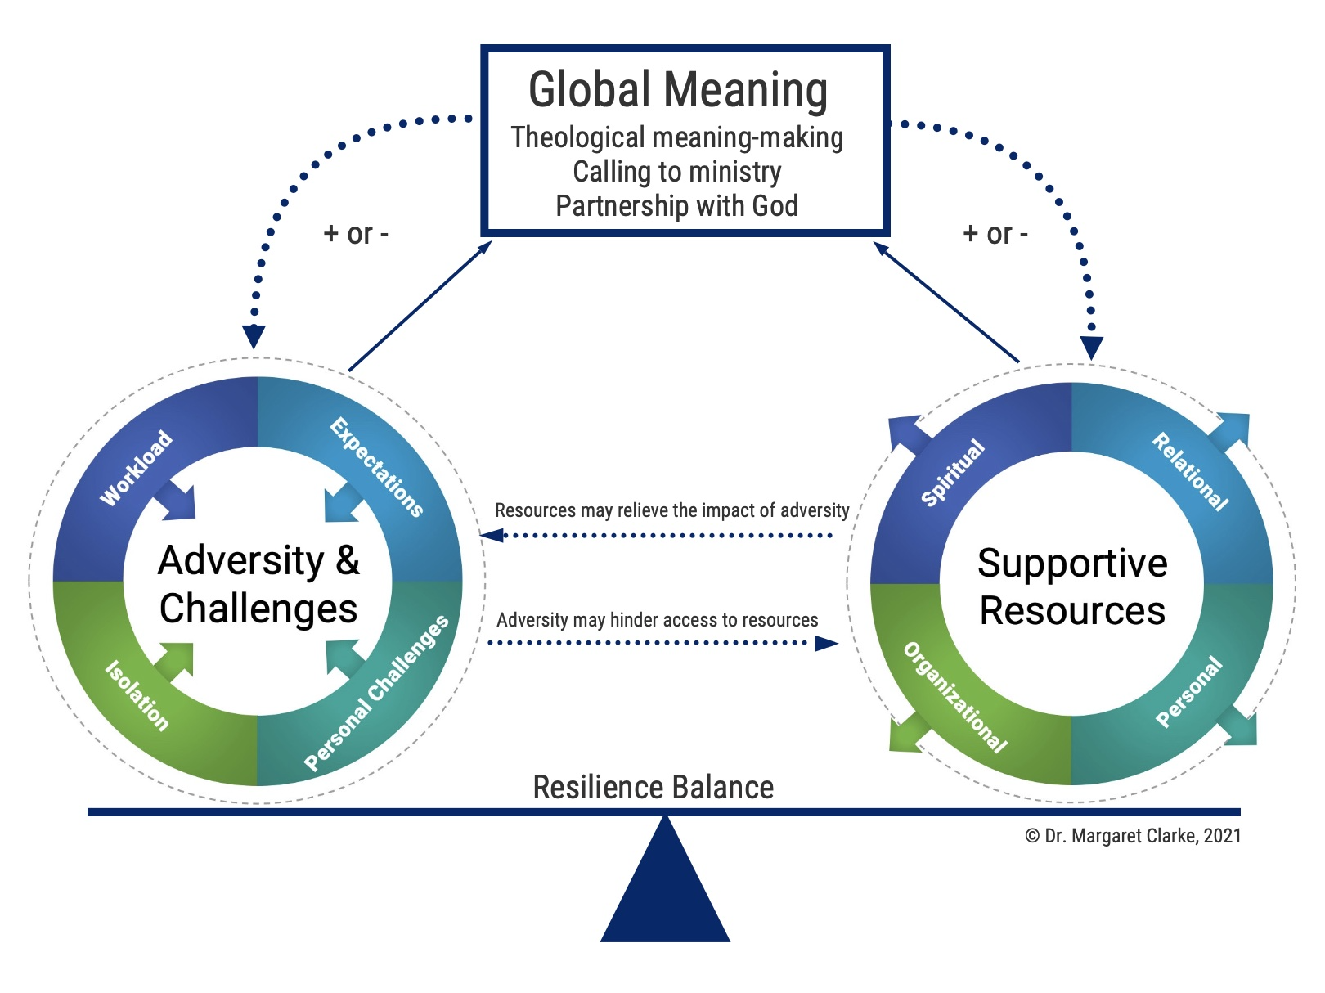
Clergy Resilience Model

Slide 5
Break-off Discussions
What helps you bounce back from adversity and challenges you encounter?

Slide 6
Resources that Support Clergy Resilience
Spiritual
Spiritual
Relational
Spiritual life has an overarching impact
Clear purpose and calling, theological meaning-making, relationship with God, communal faith, spiritual practices
Organizational
Personal

Slide 7
Resources that Support Clergy Resilience
Relational
Spiritual
Relational
Supportive Resources
Relationships with various people are supportive
Spouse/family, friends, peers, mentors, supervisor, congregants, professionals
Organizational
Personal

Slide 8
Resources that Support Clergy Resilience
Personal
Spiritual
Relational
Supportive Resources
Various practices and qualities enhance resilience
Balance, caring for health, boundaries, self-awareness, lifelong learning, institutional alignment, personal attributes
Organizational
Personal

Slide 9
Resources that Support Clergy Resilience
Organizational
Spiritual
Relational
Supportive Resources
Specific organizational practices are supportive
Provision, role flexibility, rigorous discernment preparation processes, early ministry supports, skill specific training and supports, relational opportunities
Organizational
Personal

Slide 10
Break-off Discussions
In your life, what helps you stay connected to resources that support your resilience and well-being?

Slide 11
Margaret Clarke
mclarke@briercrest.ca

Slide 12
Clarke, M. (2022). The Clergy Resilience Model: A Tool for Supporting Clergy Well-being. Journal of Psychology and Theology, 00916471221137546.
Clarke, M., Spurr, S., & Walker, K. (2022). The well-being and resilience of Canadian Christian clergy. Pastoral Psychology, 71(5), 597-613.
Clarke, M., Walker, K., Spurr, S., & Squires, V. (2022). Clergy Resilience: Accessing Supportive Resources to Balance the Impact of Role-Related Stress and Adversity. Journal of Pastoral Care & Counseling, 1-14, DOI: 10.1177/15423050221090864
Clarke, M., Walker, K., Spurr, S., & Squires, V. (2022). Role-related stress and adversity impacting Christian clergy resilience: A pan-Canadian study., 15423050221133033. Journal of Pastoral Care & Counseling

