Slide 1
Mapping the Landscape: ALLLM survey of Lifelong Learning Programs
Helen Blier, Ph.D.
President, association of leaders in lifelong learning for ministry (alllm)
September 2023

Slide 2
ALLLM Survey 411
WHO?
ATS member schools ( 67 respondents; 86 programs in 273 schools)*
WHAT?
Info on programs, directors, institutional support
WHEN?
Nov. 2020-Mar. 2021
WHY?
Map landscape of Lifelong Learning (primarily North America) for the first time in 4 decades
*FOLLOWUP?
Theological schools, judicatories, parachurch/independent orgs –anticipated Summer 2024

Slide 3
Hot Takes:
1. LLL Directors are smart and resilient (and spin straw from gold)!
2. Covid was a boon for LLL programs!
3. There’s a fracture between:
The needs of the constituents and the programs offered
The perceptions of LLL leaders and their host institutions
LLL leaders themselves
Notes:
36 of 67 respondents hold doctorate
We are scholar / practitioners, adaptive learners
We evaluate, evaluate, evaluate!
60 of 67 design >75% of programs in-house
Lifelong learners!
Staff size:
Budget
Number of People served
Expectations
Impact on programs
Impact on staff and budget

Slide 4
Breakout questions
If you serve in a theological school, judicatory, or other provider of LLL:
-do you offer lifelong learning opportunities for ministers and congregational leaders? If so, what does it look like?
If you’re a practitioner:
-where do you go for lifelong learning to refresh your vocation or hone your skills?

Slide 5
PROGRAM CONTENT AREAS ATS Mapping the Workforce Alum Study 2017
Competencies used at work:
What they wished they’d learned:

Slide 6
ALLLM—Content Areas Offered by Respondents
Leadership Development
Spirituality/theology tied
Pastoral Care
Bible
Special topics
Other: few entries, incl public theology and Christian ed
Notes:
So, are LLL programs aligned with perceived needs? Yes and no. “LD” a broad topic – anecdotally, most programs address clergy leaders and problems/identity issues as clergy. The pre-scan of programs we did before distributing survey shows few if any addressing many of the specific needs in the ATS list.
Observation: the content areas align with seminary curricula. “more of the same?” Where is the creativity exercised? Looking back at the professions pursued by graduates, broad understanding of ministry – would these people find a home in your institution’s programming?

Slide 7
PERCEPTIONS OF LLL LEADERS: What are your program’s growing edges?

Slide 8
What will your program be like in 5 years?

Slide 9
What do you need in order to thrive?

Slide 10
ALLLM—Director Perspectives
Strongly Strongly
Disagree Agree
Notes:
Institutional
I am included in the decisions at my institution that affect my area of work. (4.07)
I feel as though my organization’s leadership actively affirms the importance of this work. (3.9)
The work of LLL is integral to the mission of my organization. (3.86)
The importance of LLL is reflected in key documents for the organization, including mission and vision statements, constitution, strategic plans, etc. (3.73)
Personal
The work that I do is aligned with my personal sense of vocation. (4.47)
I feel a sense of professional satisfaction in the work that I do. (4.44)
I experience support from my colleagues and co-workers for the work that I do. (4.36)
Lifelong learning is the future of theological and religious education. (4.3)
I experience support from my administration for the work that I do. (4.2)
I have access to what I need in order to grow and thrive in my position. (3.95)
I have concerns about the future of my area of work in my institution. (2.79)
Hot take: they derive more personal fulfillment than they feel institutional support. They like what they do, and it is fulfilling! But the institution does not seem to mirror the directors’ sense of the importance of the work. This is also reflected in the number of people who said it was hard to predict the futures of their programs and professed need for more staffing and funding to do their job well.
Seminaries do not appear to be structuring these offices and positions in a way that reflects the perceived importance of this work. All but 11 say that they have additional duties – sometimes numerous ones – in their institutions. Many have some $ support for prof development, but no time for sabbatical or other support for growing and expanding personal skill set.

Slide 11
How else are LLL leaders supported professionally?
3 /4 have additional institutional responsibilities
9 of 10 have access to professional development funds:
BUT…. 2 /3 can’t take sabbatical
Additional support: “Space and permission.” “Encouragement.” “Lifelong learning is valued.”
BUT…. “I think they would if I asked. But not in a standard quantifiable way.” “Intention is good but responsibilities and time constraints limit benefit.”

Slide 12
“What else would you like to say?”
“The institution does not see LLL as essential to the mission.”
“Is there a pill that opens the eyes of administrators to the critical importance of LLL?”
“LLL was shut down at my institution 5y ago. A new program was begun and expected to be self-sustaining in 3y.”
_____
“We are considered the growing edge rather than a fringe program.”

Slide 13
Breakout questions
1. What struck you most in the previous data?
2. What one or two questions about lifelong learning and ministry were sparked for you today and will stay with you after you sign off?

Slide 14
What’s next?
-Ongoing ALLLM partnership with Association of Theological Schools
-3y Wabash grant to convene LLL leaders (Feb 2024-Feb 2026)
-Continue research project (Summer-Fall 2024)
-Book project
- ????

Slide 15
LLL: It’s the future of theological education (and maybe always has been?)
“The times, however, are changing, and the professional model of theological education will not be as good in the next century as it was in the last one. Theological education, if it is to be as good for the future as past versions were for an earlier day, must change.”
Daniel Aleshire, “Relentless Currents of Change” in In Trust
“The school demonstrates an understanding of learning and formation as lifetime pursuits by helping students develop motivations, skills, and practices for lifelong learning.”
ATS Commission on Accrediting Standard 3.5

Slide 16
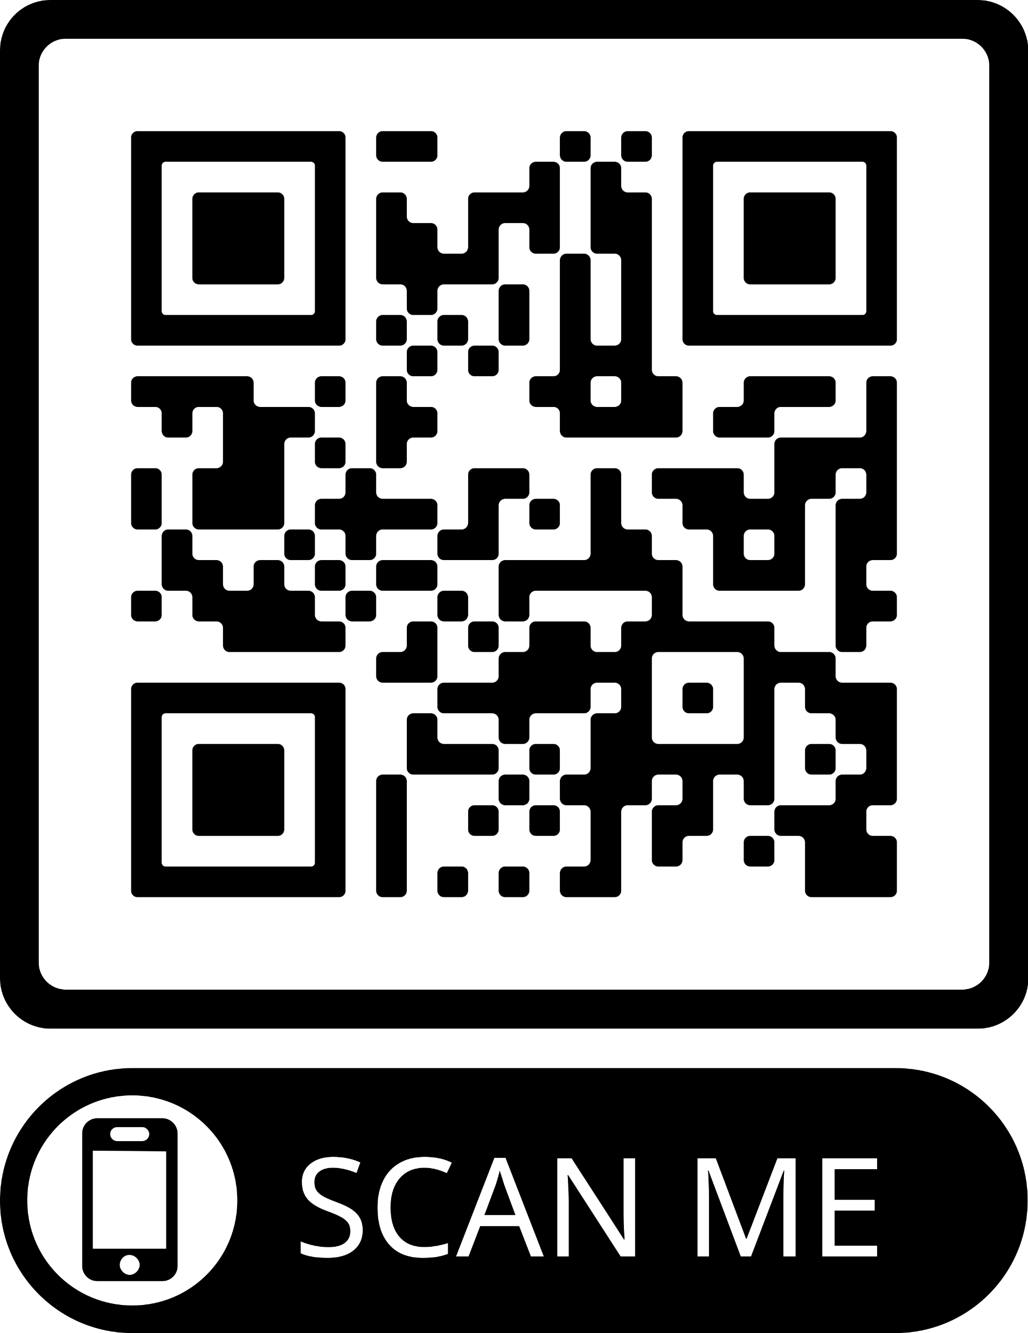
Join the team at ALLLM!

